Slide 1
Visualisation of 2010 Christchurch Boxing Day aftershock
Sung Bae (NeSI Canterbury)
Brendon Bradley (University of Canterbury )
Constantine Zakkaroff (University of Canterbury)

Slide 2
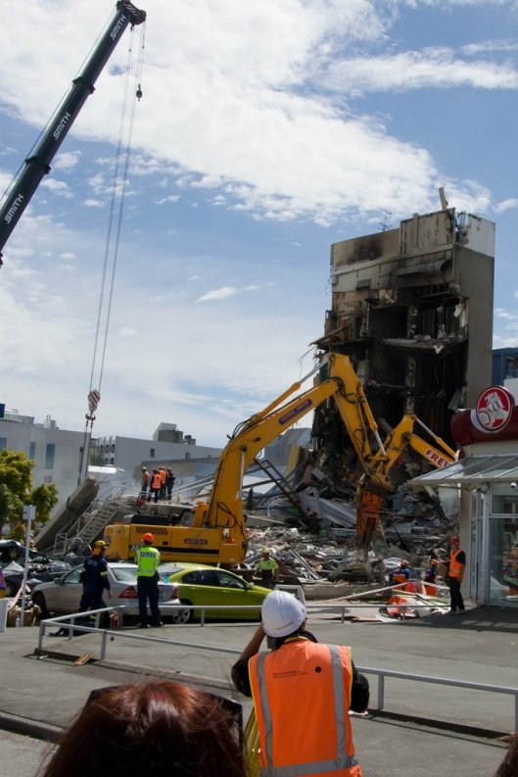
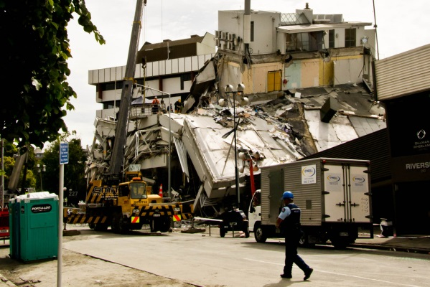
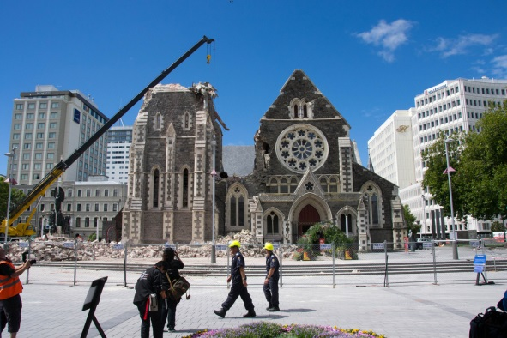
2010-2011 Canterbury Earthquake
2010-09-04 m 7.1
2011-02-22 m.6.3
185 killed
50~ 100 yrs for full recovery
Estimated cost: $40b
11,000 aftershocks (>m 2.0) by 2012-06-06

Slide 3

Ground Motion Simulation - Overview
Assoc. Prof. Brendon Bradley (UC)
3D seismic wave propagation simulations (Parallel code by Rob Graves (USGS))
Uses 4th order spatial and 2nd order temporal finite differences to solve the elastodynamic wave equation
Simulations: 4 hours @ 2048 cores on BlueGene/P

Slide 4
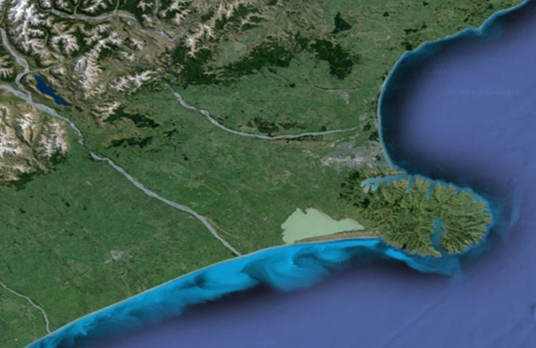
Ground Motion Simulation - 26 Dec 2010
Magnitude of 4.9
12km deep below
Opawa
Notes:
The largest of these, the "Boxing Day aftershock", with a magnitude of 4.9, at a depth of 12 km below Opawa[33] was felt very strongly and caused further damage to at least 20 buildings, the closure of the central city,[34] and cut power to more than 40,000 for some time.[35]

Slide 5
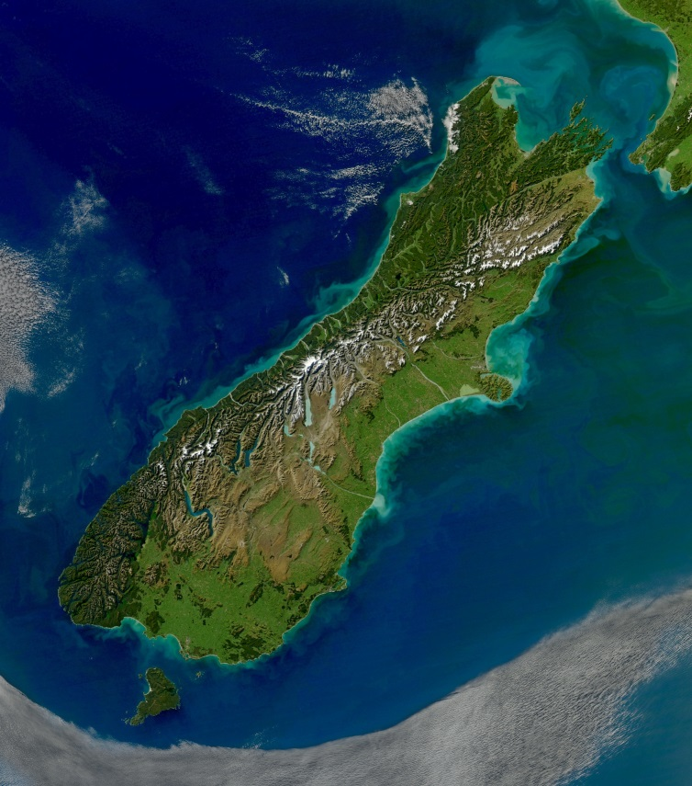
Ground Motion Simulation - Domain

Slide 6
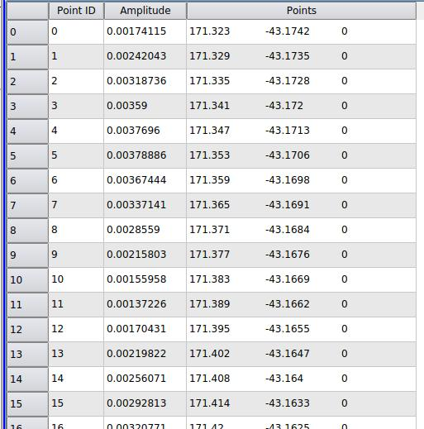
Ground Motion Simulation - Output
Particle velocity (cm/s) at 67,200 points
400 time stamps (0.1 sec) = 40secs
Visualisation can help to better understand earthquakes.

Slide 7
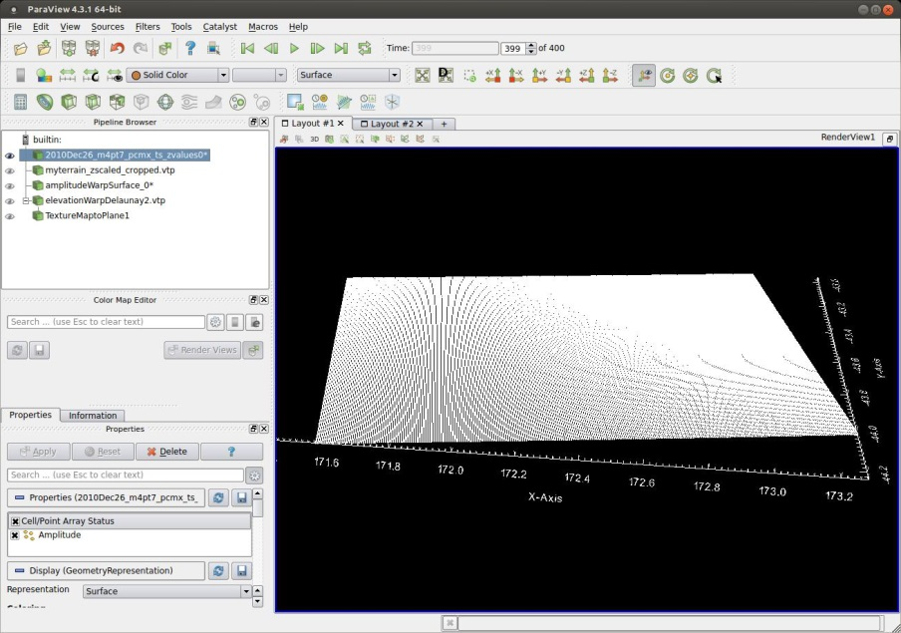

Visualisation - Overview
Viz Cluster (NeSI, BlueFern)
Paraview + VTK in-house codes

Slide 8
Visualisation I. Data imported to Paraview
Amplitude is presented on 2D plane
Notes:
400 timestamps. Raw data loaded and X,Y,Z coor data plus amplitude scalar value for each location.

Slide 9
Visualisation II. GeoTIFF data into Paraview
Cropped to fit the domain and converted to VTP format
Notes:
Source? Supplied by Brendon. Processed within VTK
1834251 points

Slide 10
Visualisation III. Terrain surface interpolation
Using 2D Delaunay interpolation

Slide 11
Visualisation IV. Terrain texture mapping
Satellite image obtained from Google Earth (screen captured) and “Photoshop”ped (Thanks to John Rugis for texture mapping technique)
Notes:
Topography texture mapped onto terrain surface. Texture image obtained from Google Earth (low res, screen captured)

Slide 12
Visualisation V. Warping plane of Ground motion
Notes:
Original amplitude is on the 2d plane while the terrain has ups and downs -Ground motion to follow the terrain surface Blended amplitude data and terrain data using interpolation based on VTK probe filter.

Slide 13
Visualisation VI. Show terrain + ground motion
Notes:
Ground motion surface colormap: transparent for low values Terrain surface slightly lowered to prevent interference

Slide 14

Final. Video

Slide 15
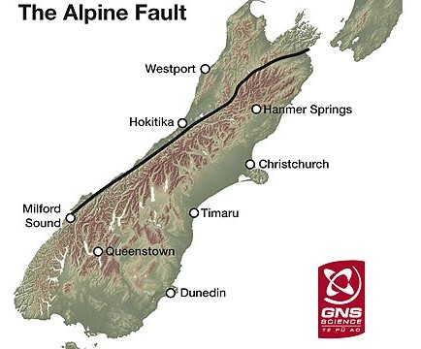
Future work
Simulations of Alpine Fault scenario
(in progress)
Source: GNS Science

Slide 16
Future work
(173.01, -42.96)
Terrain texture with high resolution
Easy NZ satellite image retrieval on coordinates input
(171.32, -43.17)
(171.57, -44.23)
(173.28, -44.01)

